Slide 1
qtrvsim 语法分析器实现及 bug 修复
PLCT 第三测试小队 阎明铸

Slide 2
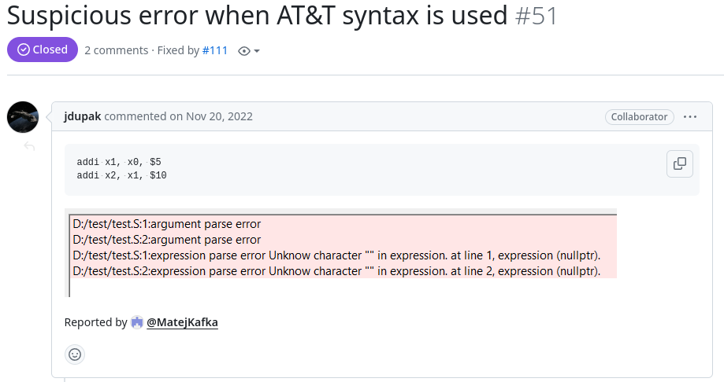
相关 issue 描述 1

Slide 3
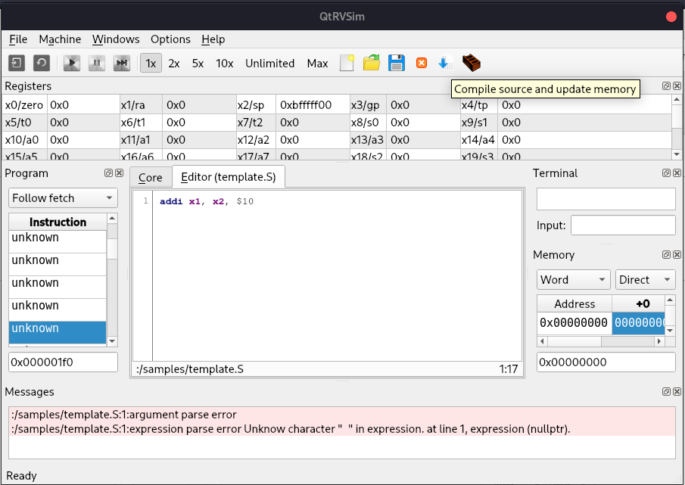
bug 复现
error message

Slide 4
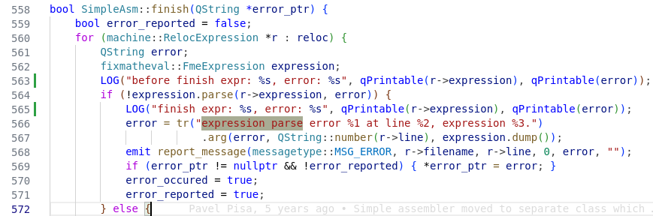
expression parse error
[INFO] assembler.fixmatheval: expression: [], size: 0

Slide 5
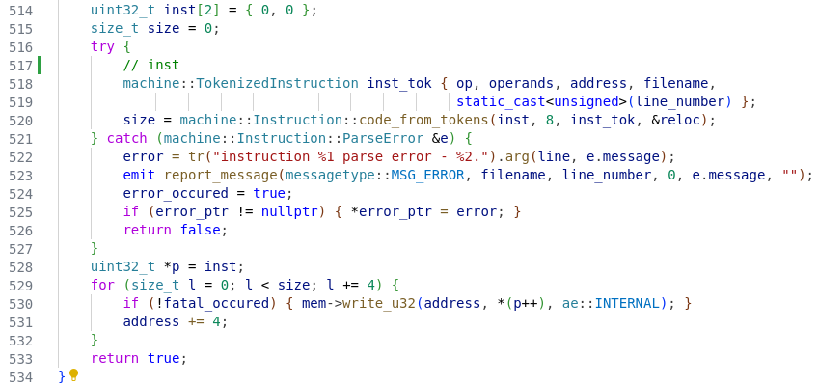
reloc 可能修改位置
src/assembler/simplasm.cpp process_line

Slide 6
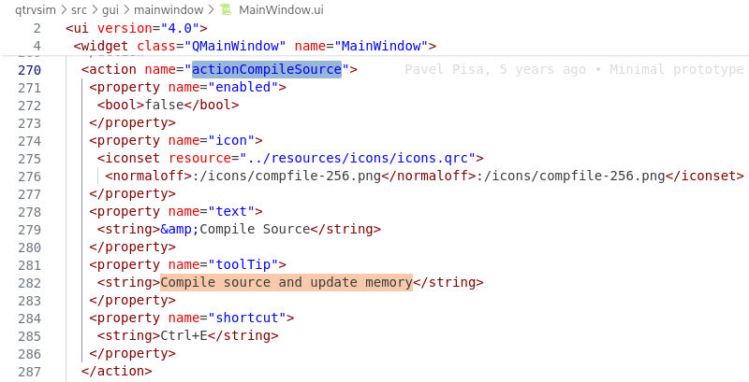
入口搜索

Slide 7
补充: QT ui 编写的两种方式
LoginWindow::LoginWindow(QWidget *parent)
: QWidget(parent)
{
// 创建UI元素
usernameEdit = new QLineEdit(this);
usernameEdit->setPlaceholderText("Username");
passwordEdit = new QLineEdit(this);
passwordEdit->setPlaceholderText("Password");
passwordEdit->setEchoMode(QLineEdit::Password);
loginButton = new QPushButton("Login", this);
messageLabel = new QLabel(this);
// 布局
QVBoxLayout *layout = new QVBoxLayout;
layout->addWidget(usernameEdit);
layout->addWidget(passwordEdit);
layout->addWidget(loginButton);
layout->addWidget(messageLabel);
setLayout(layout);
}
<?xml version="1.0" encoding="UTF-8"?>
<ui version="4.0"> <class>LoginWindow</class> <widget class="QWidget" name="LoginWindow">
// 登录窗口
<property name="geometry"> <rect> <x>0</x> <y>0</y> <width>400</width> <height>200</height> </rect> </property>
// 垂直布局
<layout class="QVBoxLayout" name="verticalLayout"> <item>
// 按钮
<widget class="QPushButton" name="loginButton"> <property name="text"> <string>Login</string> </property> </widget> </item> </layout> </widget> <resources/> <connections/>
</ui>

Slide 8
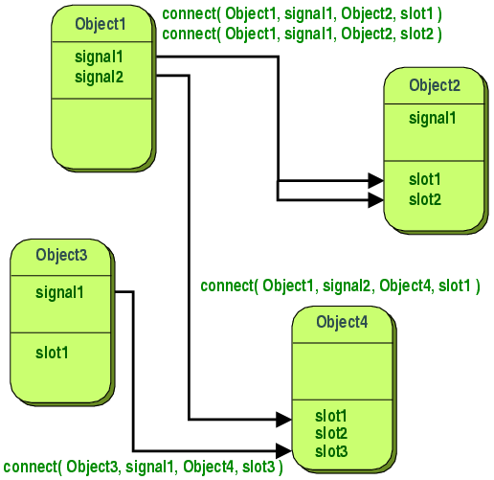
补充: QT 触发点击事件 (Signals & Slots)
LoginWindow::LoginWindow(QWidget *parent)
: QWidget(parent)
{
// 创建UI元素
loginButton = new QPushButton("Login", this);
// 连接信号和槽
connect(
loginButton, &QPushButton::clicked,
this, &LoginWindow::attemptLogin
);
// 创建布局
...
}
void LoginWindow::attemptLogin()
{
// 检查用户名和密码是否有效
if (usernameEdit->text() == "admin" && passwordEdit->text() == "password") {
...
}
}

Slide 9
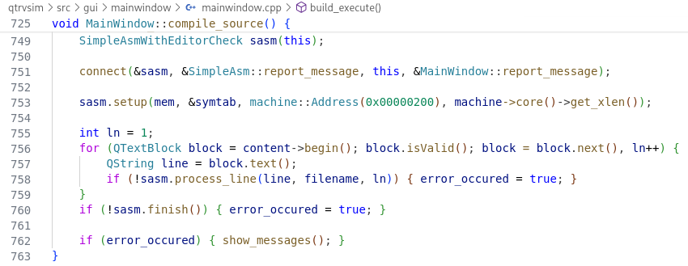
src/gui/mainwindow compile_source

Slide 10
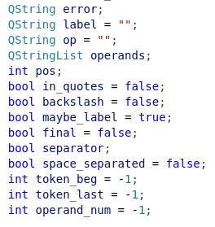
词法分析 PART I
filename, line 用于日志记录等...
error 当解析出错后会利用 connect 在 ui 显示错误消息
pos, final 解析到当前行的第 pos 个字符
op, operands, operands_num 操作, 操作数, 操作数数量
maybe_label, label 跳转位置
in_quotes, backslash 字符串及转义处理
seperator 处理操作数之间的空格等...
space_separated
token_beg 记录 token 解析位置
token_last

Slide 11
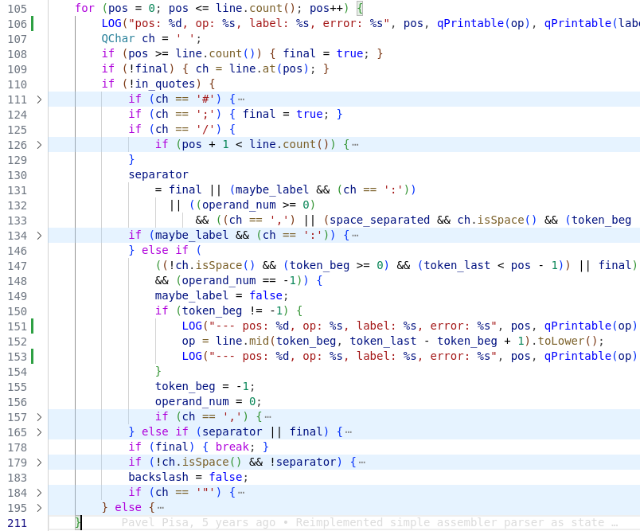
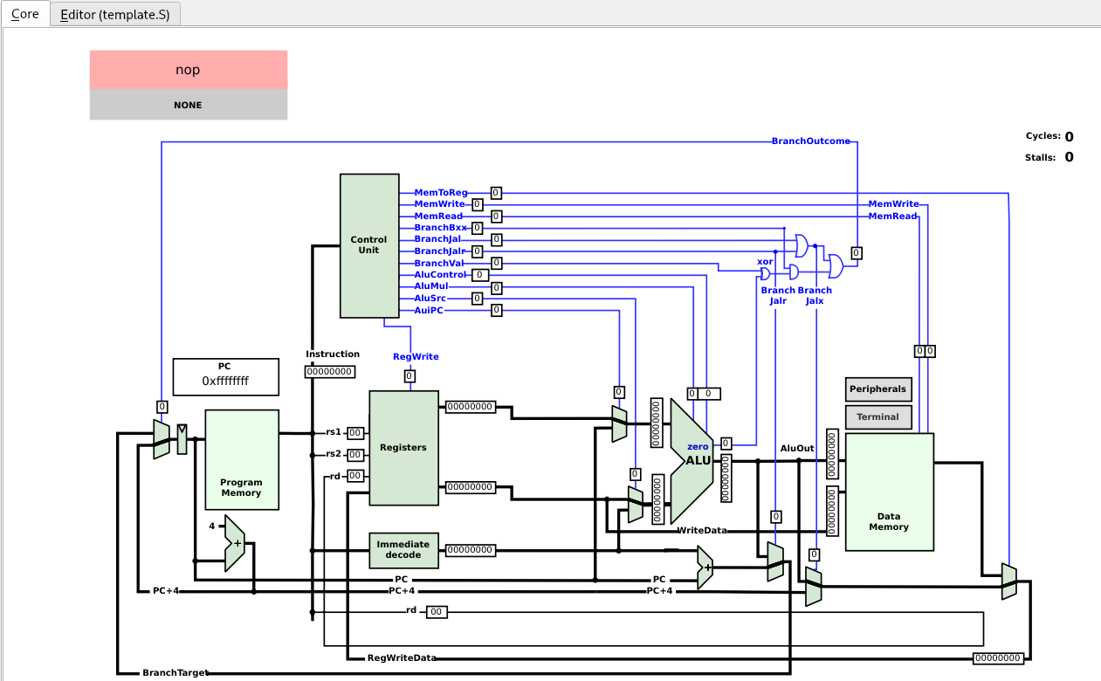
词法分析 PART II
op: addi, #progma, #include, .text
// Directives to make interesting windows visible
#pragma qtrvsim show terminal
#pragma qtrvsim show registers
#pragma qtrvsim show memory
// 如果编译成功, 就从代码编辑 自动切换到 core tab页面
#pragma qtrvsim tab core

Slide 12
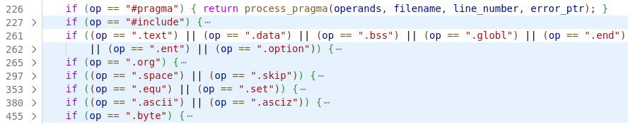
词法分析 PART III
除了常规的 sections, qtrvsim 还定义了自己的 sections, 例如
.ascii, .byte 可以直接在内存中写入数据
.set 可以直接在符号表中设置符号

Slide 13
词法分析 PART IV

Slide 14
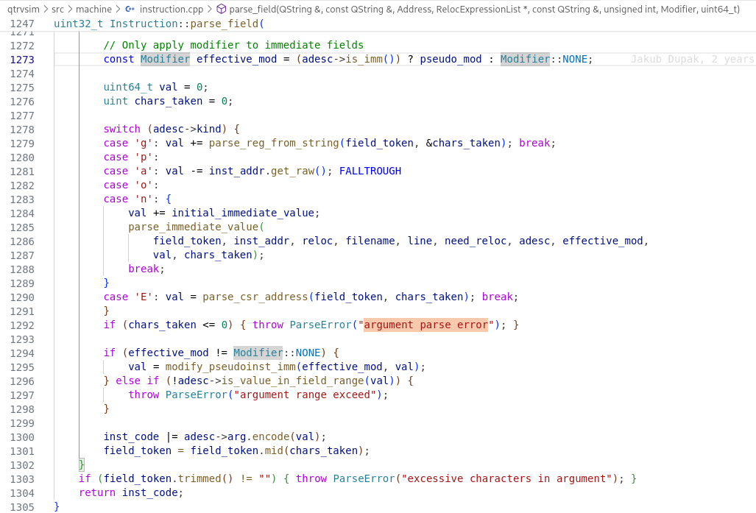
argement parse error 触发位置
bool SimpleAsm::process_line
Instruction::code_from_tokens
Instruction::base_from_tokens
Instruction::parse_field

Slide 15
语法分析
size_t Instruction::code_from_tokens(
uint32_t *code,
size_t buffsize,
TokenizedInstruction &inst,
RelocExpressionList *reloc,
bool pseudoinst_enabled) {
// 初始化 instruction code Map
if (str_to_instruction_code_map.isEmpty()) {
instruction_from_string_build_base();
}
// 解析基本指令
Instruction result = base_from_tokens(inst, reloc);
if (result.data() != 0) {
...
return result.size();
}
// 解析伪指令
if (pseudoinst_enabled) {
size_t pseudo_result = pseudo_from_tokens(code, buffsize, inst, reloc);
if (pseudo_result != 0) { return pseudo_result; }
}
throw ParseError("unknown instruction");
}
QMultiMap<QString, uint32_t> str_to_instruction_code_map;
addi, 0x13
const InstructionMap *im = &InstructionMapFind(inst_code);

Slide 16
inst_map
src/machine/instruction.cpp
static const struct InstructionMap C_inst_map[] = {
IM_UNKNOWN,
IM_UNKNOWN,
IM_UNKNOWN,
{"i", IT_UNKNOWN, NOALU, NOMEM, I_inst_map, {}, 0x3, 0x3, { .subfield = {5, 2} }, nullptr},
};
code
5: count 比特位数
name
名称
type
指令类型
例如
R 型, I, S
B, AMO,...
alu
对应的
逻辑
运算
单元
ADD
AND
OR
memctl
用于
A 拓
展
subclasss
子集
mask
2: offset 偏移量
aliases
别名
args
操作数
类型
struct InstructionMap {
const char *name;
Instruction::Type type = Instruction::UNKNOWN;
AluCombinedOp alu = { .alu_op = AluOp::ADD } ;
AccessControl mem_ctl = AC_NONE;
const struct InstructionMap *subclass = nullptr; // when subclass is used then flags
// has special meaning
const cvector<QString, 3> args;
uint32_t code;
uint32_t mask;
union {
decltype(underlying_type<InstructionFlags>::type()) flags;
BitField subfield;
};
const InstructionMap *aliases = nullptr;
};

Slide 17
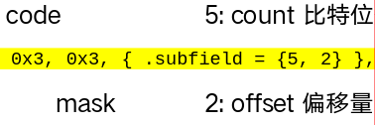
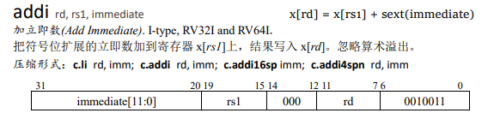
补充: count 和 offset
struct BitField {
uint8_t count;
uint8_t offset;
};
offset: 所有 I 型指令最后都是 11, 所以偏移 = 2
count: 区分指令类型的为 op 高 5 位

Slide 18
InstructionMap
static const struct InstructionMap I_inst_map[] = {
{"load", IT_I, NOALU, NOMEM, LOAD_map, {}, 0x03, 0x7f, { .subfield = {3, 12} }, nullptr}, // LOAD
IM_UNKNOWN, // LOAD-FP
IM_UNKNOWN, // custom-0
{"misc-mem", IT_I, NOALU, NOMEM, MISC_MEM_map, {}, 0x0f, 0x7f, { .subfield = {3, 12} }, nullptr}, // MISC-MEM
{"op-imm", IT_I, NOALU, NOMEM, OP_IMM_map, {}, 0x13, 0x7f, { .subfield = {3, 12} }, nullptr}, // OP-IMM
...
{"amo", IT_R, NOALU, NOMEM, AMO_map, {}, 0x2f, 0x7f, { .subfield = {3, 12} }, nullptr}, // OP-32
...
}
操作码

Slide 19
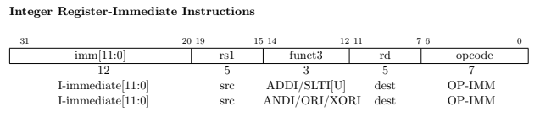
InstructionMap
static const struct InstructionMap OP_IMM_map[] = {
{
"addi", IT_I, { .alu_op=AluOp::ADD }, NOMEM, nullptr, {"d", "s", "j"},
0x00000013,0x0000707f, { .flags = FLAGS_ALU_I }, inst_aliases_addi}, // ADDI
{"slli", IT_I, { .alu_op=AluOp::SLL }, NOMEM, nullptr, {"d", "s", ">"}, 0x00001013,0xfc00707f, { .flags = FLAGS_ALU_I }, nullptr}, // SLLI
{"slti", IT_I, { .alu_op=AluOp::SLT }, NOMEM, nullptr, {"d", "s", "j"}, 0x00002013,0x0000707f, { .flags = FLAGS_ALU_I }, nullptr}, // SLTI
{"sltiu", IT_I, { .alu_op=AluOp::SLTU }, NOMEM, nullptr, {"d", "s", "j"}, 0x00003013,0x0000707f, { .flags = FLAGS_ALU_I }, inst_aliases_sltiu}, // SLTIU
{"xori", IT_I, { .alu_op=AluOp::XOR }, NOMEM, nullptr, {"d", "s", "j"}, 0x00004013,0x0000707f, { .flags = FLAGS_ALU_I }, inst_aliases_xori}, // XORI
{"sri", IT_I, NOALU, NOMEM, SRI_map, {}, 0x00005013, 0xbe00707f, { .subfield = {1, 30} }, nullptr}, // SRLI, SRAI
{"ori", IT_I, { .alu_op=AluOp::OR }, NOMEM, nullptr, {"d", "s", "j"}, 0x00006013,0x0000707f, { .flags = FLAGS_ALU_I }, nullptr}, // ORI
{"andi", IT_I, { .alu_op=AluOp::AND }, NOMEM, nullptr, {"d", "s", "j"}, 0x00007013,0x0000707f, { .flags = FLAGS_ALU_I }, inst_aliases_andi}, // ANDI
};

Slide 20
补充: code 计算
计算公式 code = base_code | (i << shift)
code = 0 | (0011 << 0 ) = 0011 = 0x3
第 4 个
{"i", IT_UNKNOWN, NOALU, NOMEM, I_inst_map, {}, 0x3, 0x3, { .subfield = {5, 2} }, nullptr}
code = 0011 | (0101 << 2 ) =10111 = 0x13
第 5 个
{"op-imm", IT_I, NOALU, NOMEM, OP_IMM_map, {}, 0x13, 0x7f, { .subfield = {3, 12} }, nullptr},
如果没有子集, 直接使用 code
{"addi", IT_I, { .alu_op=AluOp::ADD }, NOMEM, nullptr, {"d", "s", "j"}, 0x00000013,0x0000707f, { .flags = FLAGS_ALU_I }, inst_aliases_addi}, // ADDI

Slide 21
补充: 根据 code 反推出结构体
const BitField instruction_map_opcode_field = { .count = 2, .offset = 0 };
static inline const struct InstructionMap &InstructionMapFind(uint32_t code) {
const struct InstructionMap *im = &C_inst_map[instruction_map_opcode_field.decode(code)];
while (im->subclass != nullptr) {
im = &im->subclass[im->subfield.decode(code)];
}
if ((code ^ im->code) & im->mask) {
return C_inst_unknown;
}
return *im;
}
decode: (val >> offset) & (((uint64_t)1 << count) - 1), 计算出在子集中的索引
推出是 I 格式指令: 10011 >> 0 & ((1 << 2) - 1) = 10111 & 0011 = 0011 = 3
addi code: 0x13 (10011)
{"i", IT_UNKNOWN, NOALU, NOMEM, I_inst_map, {}, 0x3, 0x3, { .subfield = {5, 2} }, nullptr}
推出是 op-imm: 10011 >> 2 & ((1 << 5) - 1) = 0100 & 1111 = 0100 = 4

Slide 22
base_from_tokens
const InstructionMap *im = &InstructionMapFind(inst_code);
inst_code = im->code;
for (int field_index = 0; field_index < (int)im->args.size(); field_index++) {
const QString &arg = im->args[field_index];
QString field_token = inst.fields[field_index];
inst_code |= parse_field(
field_token, arg, inst.address, reloc, inst.filename, inst.line, pseudo_mod,
initial_immediate_value);
}
return Instruction(inst_code);
addi, x1, x2, $10
{"d", "s", "j"},

Slide 23
token 解析
/**
* Possible values:
* @val g: (寄存器ID) gp register id
* @val n: (立即数)numeric immediate
* @val a: (pc 相对地址偏移)pc relative address offset * @val o: (偏移量立即数)offset immediate
*/
for (QChar ao : arg) {
bool need_reloc = false; // Only apply modifier to immediate fields
switch (adesc->kind) {
case 'g': val += parse_reg_from_string(field_token, &chars_taken); break;
case 'p':
case 'a': val -= inst_addr.get_raw(); FALLTROUGH
case 'o':
case 'n': {
val += initial_immediate_value;
parse_immediate_value(
field_token, inst_addr, reloc, filename, line, need_reloc, adesc, effective_mod,
val, chars_taken));
break;
}
case 'E': val = parse_csr_address(field_token, chars_taken); break;
}
if (chars_taken <= 0) { throw ParseError("argument parse error"); }
inst_code |= adesc->arg.encode(val);
field_token = field_token.mid(chars_taken);
}
if (field_token.trimmed() != "") { throw ParseError("excessive characters in argument"); }
return inst_code;

Slide 24
立即数解析
bool parse_immediate_value(...) {
if (field_token.at(0).isDigit() || field_token.at(0) == '-' || (reloc == nullptr)) {
uint64_t num_val = 0; int i;
char cstr[field_token.count() + 1];
cstr[i] = 0;
const char *p = cstr;
char *r;
if (adesc->min < 0) {
num_val = strtoll(p, &r, 0);
} else {
num_val = strtoull(p, &r, 0);
}
while (*r && isspace(*r)) {
r++;
}
chars_taken = r - p;
if (*r && strchr("+-/*|&^~", *r)) {
need_reloc = true;
} else {
// extend signed bits
val += num_val;
}
} else {
need_reloc = true;
}
if (need_reloc && (reloc != nullptr)) {
reloc_append(
reloc, field_token, inst_addr, val, adesc, &chars_taken, filename, line, effective_mod);
val = 0;
}
return chars_taken != 0;
}
if (!parse_immediate_value(
field_token, inst_addr, reloc, filename, line, need_reloc, adesc, effective_mod,
val, chars_taken)) {
throw ParseError(QString("field_token %1 is not a valid immediate value").arg(field_token));
}

Slide 25
其他: 伪指令解析
// pseudo_from_tokens
if ((inst.base == QLatin1String("li")) && (buffsize >= 8)) {
if (inst.fields.size() != 2) { throw ParseError("number of arguments does not match"); }
*code = base_from_tokens(
{ "lui", inst.fields, inst.address, inst.filename, inst.line }, reloc, UPPER)
.data();
code += 1;
inst.fields.insert(0, inst.fields.at(0));
*code
= base_from_tokens(
{ "addi", inst.fields, inst.address + 4, inst.filename, inst.line }, reloc, LOWER)
.data();
return 8;
}

Slide 26
write_mem, 为运行做准备
const InstructionMap *im = &InstructionMapFind(inst_code);
inst_code = im->code;
for (int field_index = 0; field_index < (int)im->args.size(); field_index++) {
const QString &arg = im->args[field_index];
QString field_token = inst.fields[field_index];
inst_code |= parse_field(
field_token, arg, inst.address, reloc, inst.filename, inst.line, pseudo_mod,
initial_immediate_value);
}
return Instruction(inst_code);
process_line 末尾
uint32_t inst[2] = { 0, 0 };
uint32_t *p = inst;
for (size_t l = 0; l < size; l += 4) {
if (!fatal_occured) { mem->write_u32(address, *(p++), ae::INTERNAL); }
address += 4;
}

Slide 27
表达式展开, 计算, 更新
FmeNode
FmeNodeConstant
FmeNodeSymbol
FmeNodeUnaryOp
FmeNodeBinaryOp
addi x1, x2, 1 + 1
表达式的处理位于 smasm.finish() 处
bool SimpleAsm::finish(QString *error_ptr) {
bool error_reported = false;
for (machine::RelocExpression *r : reloc) {
fixmatheval::FmeExpression expression;
LOG("before finish expr: %s, error: %s", qPrintable(r->expression), qPrintable(error));
if (!expression.parse(r->expression, error)) {
fixmatheval::FmeValue value;
if (!expression.eval(value, symtab, error)) {
machine::Instruction inst(mem->read_u32(r->location, ae::INTERNAL));
if (!inst.update(value, r)) {
if (!fatal_occured) {
mem->write_u32(Address(r->location), inst.data(), ae::INTERNAL);
}
}
}
}
FmeValue (*op)(FmeValue &a, FmeValue &b)
binary_op = [](FmeValue &a, FmeValue &b) -> FmeValue {
return a + b;
};

Slide 28
Thanks

